Slide 1

Surprise Housing - Housing Price Predication & Analysis Project
By Ms. Yashshree Baviskar
Fliprobo – Internship 25

Slide 2
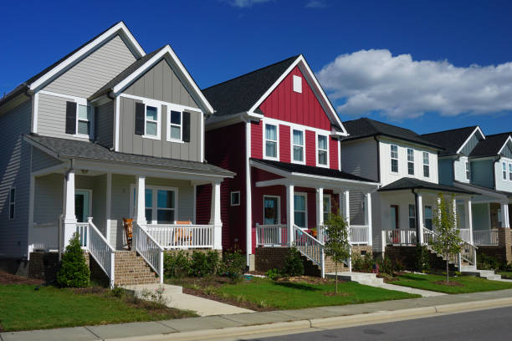
Introduction to Housing Price Prediction

Slide 3
Problem Statement
A US-based housing company named Surprise Housing has decided to enter the Australian market. The company uses data analytics to purchase houses at a price below their actual values and flip them at a higher price. For the same purpose, the company has collected a data set from the sale of houses in Australia.
It is required to build a model using Machine Learning in order to predict the actual value of the prospective properties and decide whether to invest in them or not.

Slide 4
Problem Statement
For this company wants to know:
Which variables are important to predict the price of variable?
How do these variables describe the price of the house?
How to construct a realistic model to precisely predict the price of real estate has been a challenging topic with great potential for further research.
Our main objective of doing this project is to build a model to predict the house prices with the help of other supporting features.

Slide 5
Conceptual Background
There are many factors that have an impact on house prices, such as the number of bedrooms and bathrooms. House price depends upon its location as well. A house with great accessibility to highways, schools, malls, employment opportunities, would have a greater price as compared to a house with no such accessibility.
The No Free Lunch Theorem state that algorithms perform differently when they are used under the same circumstances.
The study answers the following research questions:
Research question 1: Which machine learning algorithm performs better and has the most accurate result in house price prediction? And why?
-Research question 2: What are the factors that have affected house prices in Australia over the years?

Slide 6
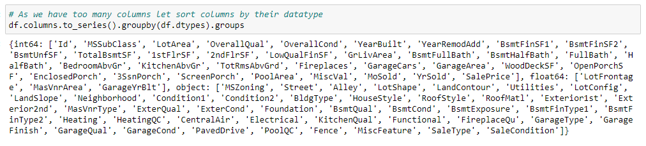
Data Sources and their formats
Data set provided by Flip Robo was in the format of CSV (Comma Separated Values). There are 2 data sets that are given. One is training data and one is testing data.
1) Train file will be used for training the model, i.e., the model will learn from this file. The dimension of data is 1168 rows and 81 columns.
2) Test file contains all the independent variables, but not the target variable. The dimension of data is 292 rows and 80 columns.

Slide 7
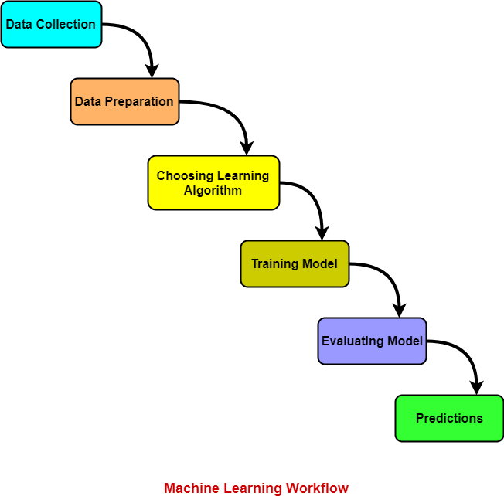
Project Flow Chart

Slide 8
Project Flow Tasks Perform
Data Integrity Check For presence of duplicate or any data error.
Missing values present in data set. Features containing more than 40% missing value are drop from investigation.
Imputation of missing value with mean, median or mode is performed.
Feature Engineering for extraction of few new features out of existing features.
Feature selection
Label Encoding of Categorical features
Splitting of dataset into input & target feature
Standard Scaling of data

Slide 9
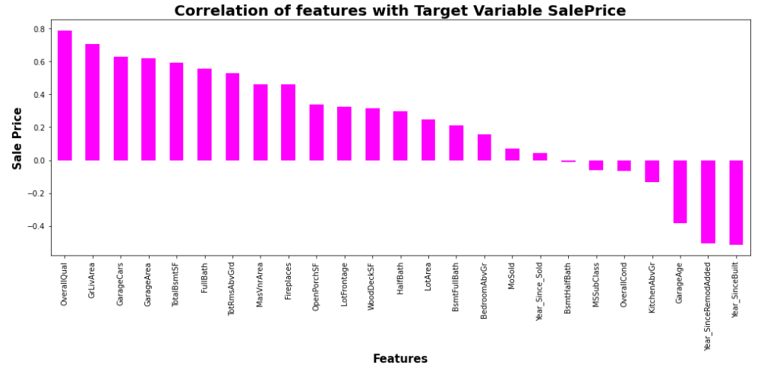
Correlation Heatmap

Slide 10

Exploratory Data Analysis
In this section we go through some key insight from dataset – As we have lot of features We see here only key visualization

Slide 11
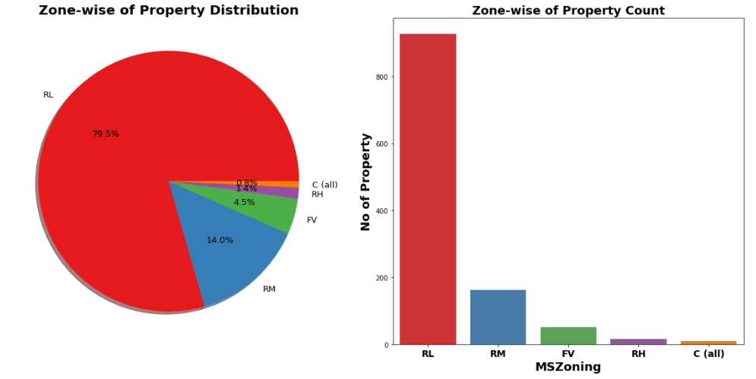
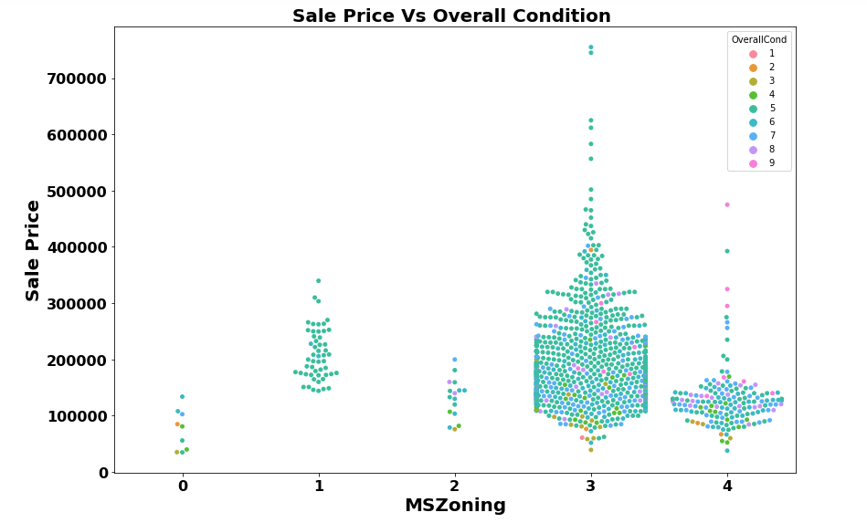
79.5% of House properties belongs to Low Density Residential Area followed by 14 % of properties belong to Medium Density Residential Area.
Very Few properties (0.8%) belong to Commercial zone.
Most of property for sale have overall condition rating of either 5 or 6.
We already know of 80% of housing data belongs to Low density Residential Area and Now we can see in Swarm Plot that Sale Price inside RL Zone is much higher than another remaining zone.
House properties having Overall condition Rating of 8 & 9 have low price compare to others. This indicate that Overall Condition Rating is Not significant factor in determination of Sale price.

Slide 12
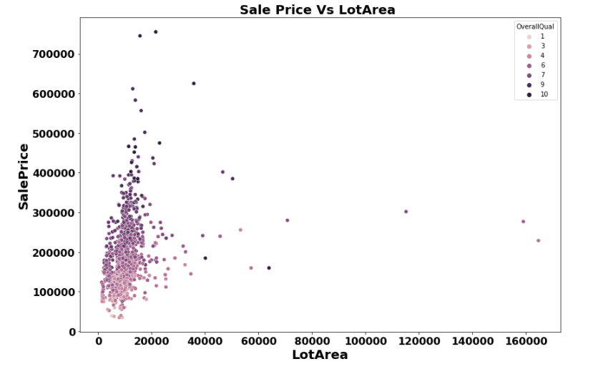
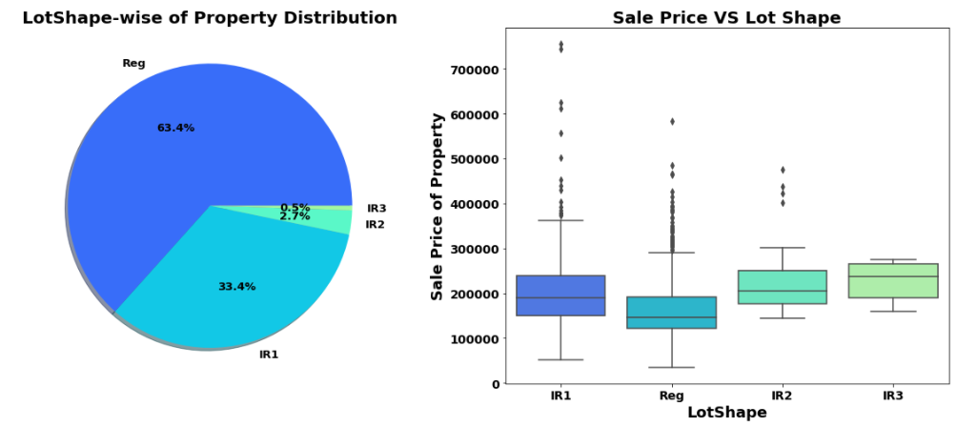
There is No Significant relationship found between Sale price & Lot area.
As Overall Quality of House Increase the Sale Price of House also Increases
63.4% house properties are regular in shape.
Sale Price of property with slight irregular shape is higher than regular shape.

Slide 13
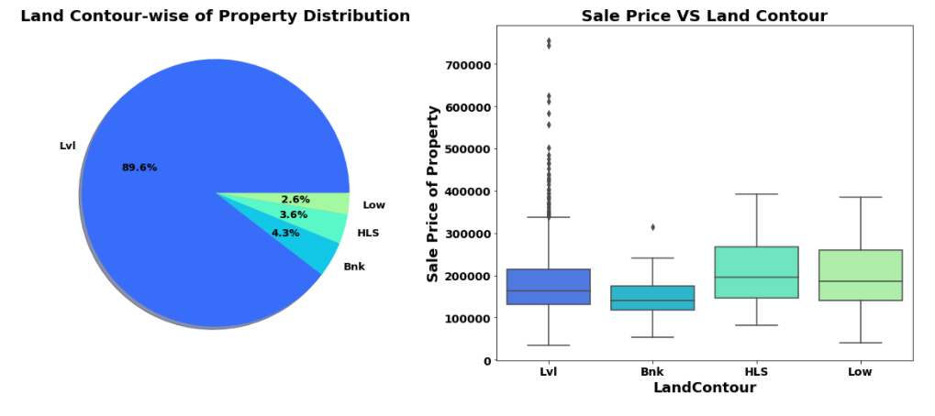
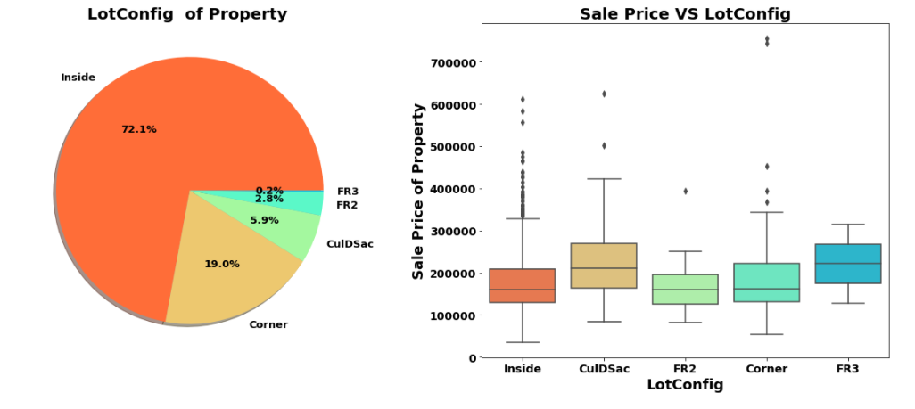
89.6% of House properties are near flat level surface.
Also, price for Flat level surface house is much higher than other land contour.
Around 72 % of house comes with inside Lot configuration.
Cul-de-sac has maximum Mean Sale Price among all lot configuration.
Cheapest Houses belong to Inside lot configuration while Costlier houses belongs to Corner Lot Configuration.

Slide 14
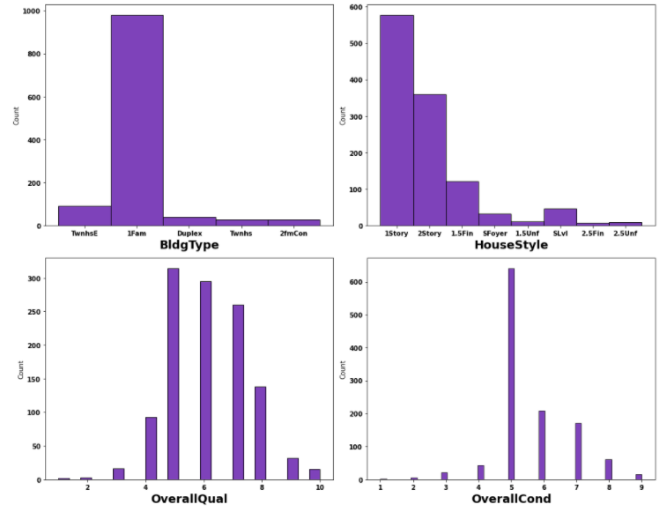
More than 950 house properties are with building type Single-family Detached.
More than 50% of house properties comes with Overall Condition Rating of 5.
More than 75% of house properties come with overall Quality Rating varies between 5 to 6.
More than 500 House Properties comes with one story dwelling.

Slide 15
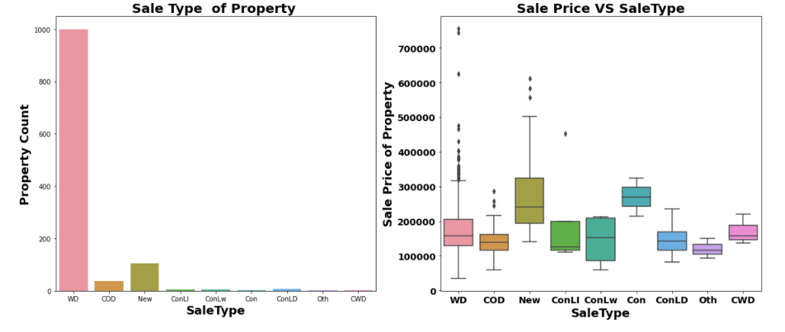
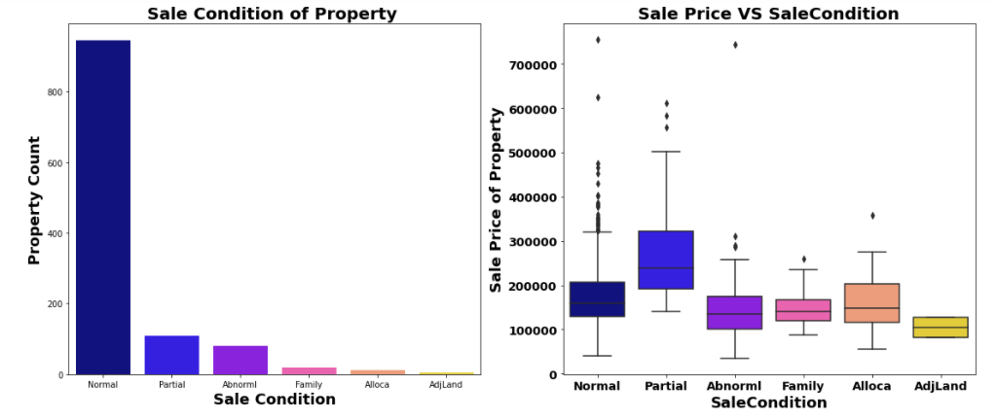
Around 1000 sales happen by Conventional Warranty Deed.
Home just constructed and sold category are exceptionally much costlier than anyone else.
All loan-based sale is below 300000.
We can see that Sale with condition like Abnorml, Family, Alloca, AdjLand are below the price of 300000.
Maximum Base Price for House comes from Partial category- (associated with Uncompleted New Home) is higher than rest.
Minimum base price comes from Normal condition sale and also highest sale price comes from this category

Slide 16
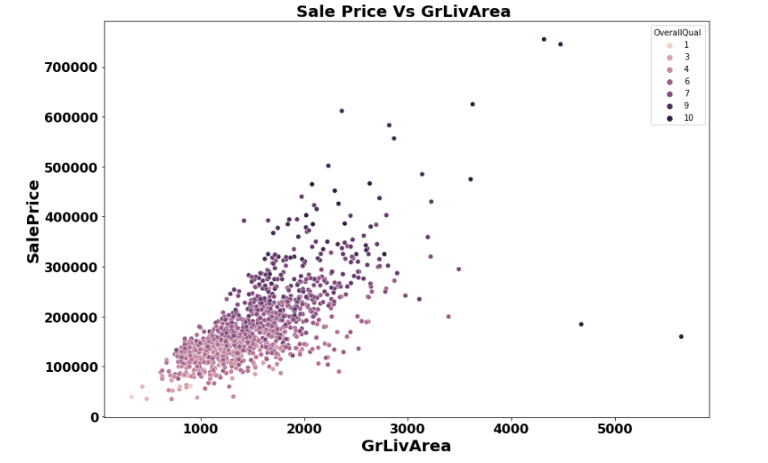
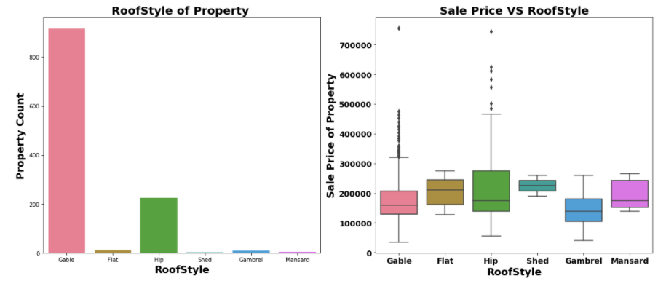
In above plot we can clearly see relation between all three feature very clearly.
As total floor area increases the sale price also get increases corresponding the overall quality of House.
More than 75% House properties come with Gable Roof Style followed by around 15 % house properties with Hip Style.
From Boxplot we can see that Hip style Roof are much costlier than remaining roof style

Slide 17
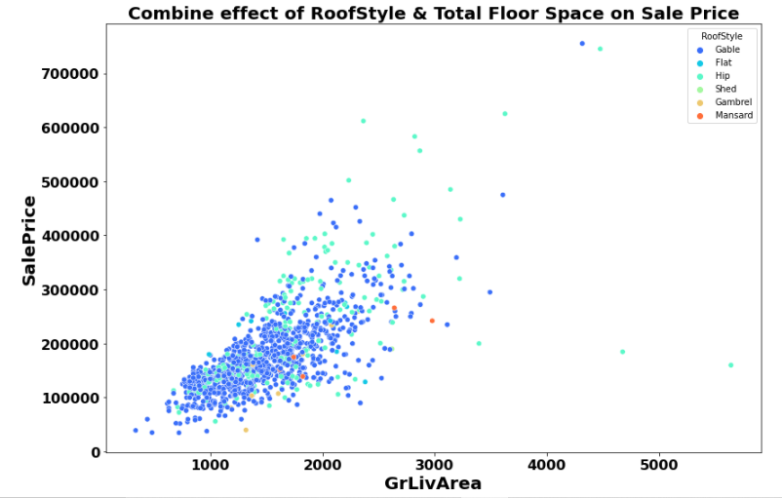
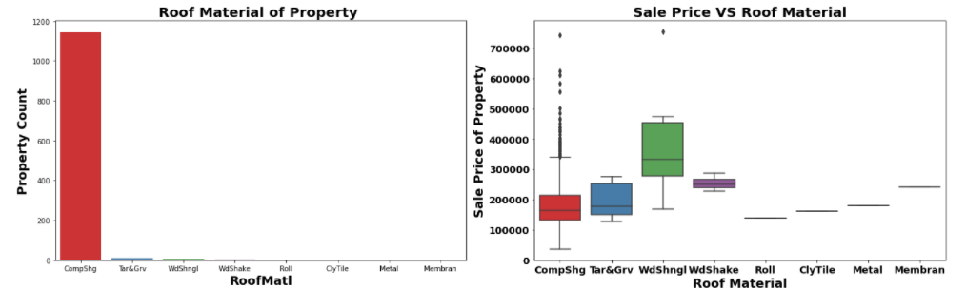
For High floor area construction mainly Hip style Roof is used and invariably high-cost properties mostly comes up with Hip Style Roof
More than 90% Properties in Data set made with roof material of Standard (Composite) Shingle.
Wood Shingles is Costlier Material compare to rest.

Slide 18
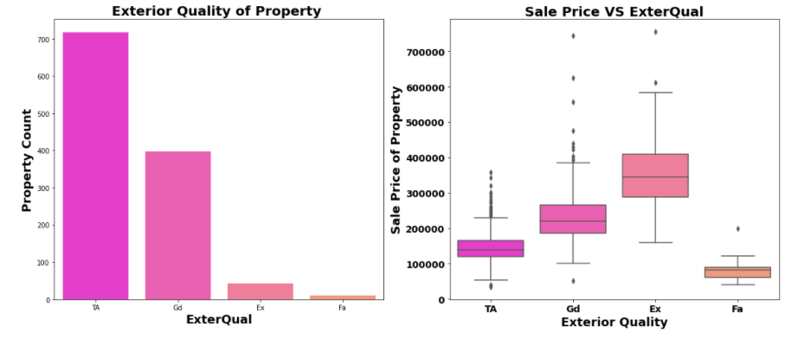
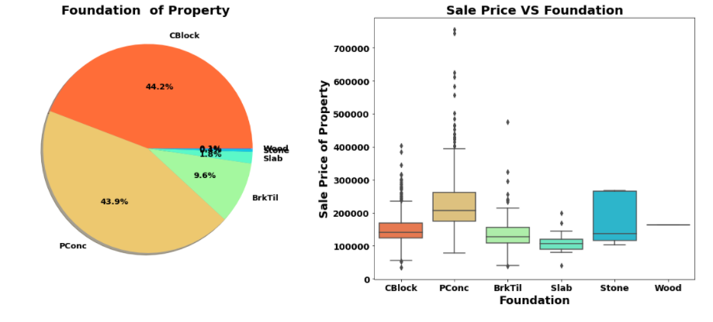
Around 60% of house properties come with Average Exterior quality and all of them below 400000.
Very few House Properties comes with Excellent Exterior Quality.
Costlier house properties come with Good & Excellent exterior quality.
44.2% Properties with CBlock Foundation & 43.9% housing property come with PConc Foundation.
Pconc Foundation are mostly use in costly housing properties.

Slide 19
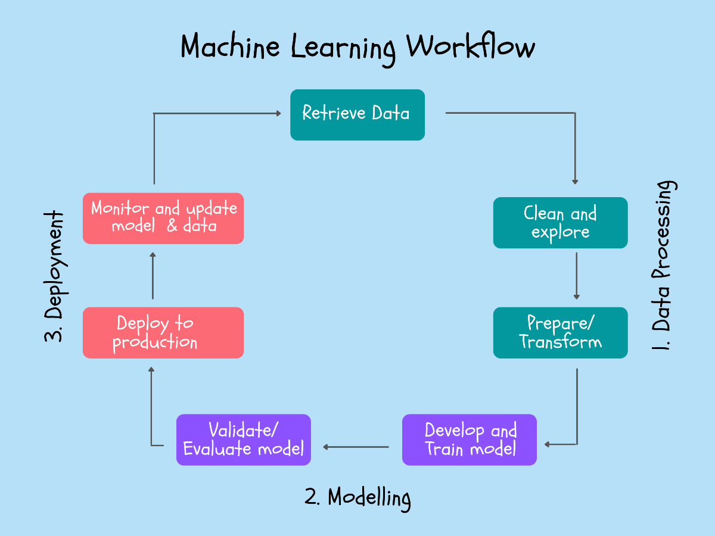
Machine Learning Model Building

Slide 20
Machine Learning Algorithm Used
The different regression algorithm used in this project to build ML model are as below:
Linear Regression
Random Forest Regressor
Decision Tree Regressor
XGB Regressor
Extra Tree Regressor
Gradient Boosting Regressor

Slide 21
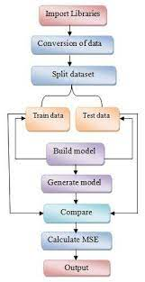
ML Model Building Flow
Standard Scaling of Data
Splitting Training Data Using test_train_split
Finding Best Random state
Training ML Model on Different Algorithms
5 Fold Cross Validation of Different Model
Selection of Best Model Based on Evaluation Criteria
Hyper Parameter Tuning of Best Model
Saving final Model Using Joblib
Predicating Test Dataset using Final Model

Slide 22
Key Findings and Conclusions of the Study
Algorithm | R2 Score | CV Score
Random Forest Regressor | 89.19 | 85.06
XGB Regressor | 89.35 | 85.34
Linear Regression | 90.97 | 86.39
Decision Tree Regressor | 66.99 | 70.80
Extra Tree Regressor | 85.40 | 84.48
Gradient Boosting Regressor | 91.57 | 86.78
Gradient Boosting Regressor Hyper Parameter Tuned Final Model | 91.29 | 86.44

Slide 23


